Slide 1
Online Scheduling

Slide 2
Timeline for Scheduling
Juniors (class of 2018) March 24 – April 10
Sophomores (class of 2019) April 17 – April 24
Freshman (class of 2020) April 24 – May 1
8th Graders (class of 2021) May 1- June
Late Schedulers May 10 – May 15
Access for all students will begin at 3 pm on the first day and close at 3 pm on the last day.

Slide 3
Plan Ahead ☺ Sophomore courses to add:
English
English 11 A
English 11 B
Social Studies (3 credits by graduation):
Civics and/or Economics
Science (3 credits by graduation):
Physics or chemistry (or other 3rd science credit)
Math (4 credits total by graduation):
Must have Alg 1, Geom, Alg2

Slide 4
Other classes to consider:
World Language
.5 Computer class if you haven’t taken it yet
PE if you haven’t completed full credit
Applied or Fine Arts if you haven’t completed full credit
DON’T FORGET TO PUT IN TIES

Slide 5
Locations for Online Scheduling
Students may schedule on any computer that is web accessible.
Most students will schedule from home.
Help is available after school in the library.

Slide 6
Online Scheduling Help Lab In Media Center
Date | Time(s)
March 24 | 3 pm- 4 pm
April 17 | 3 pm- 4 pm
April 24 | 3 pm-4 pm

Slide 7
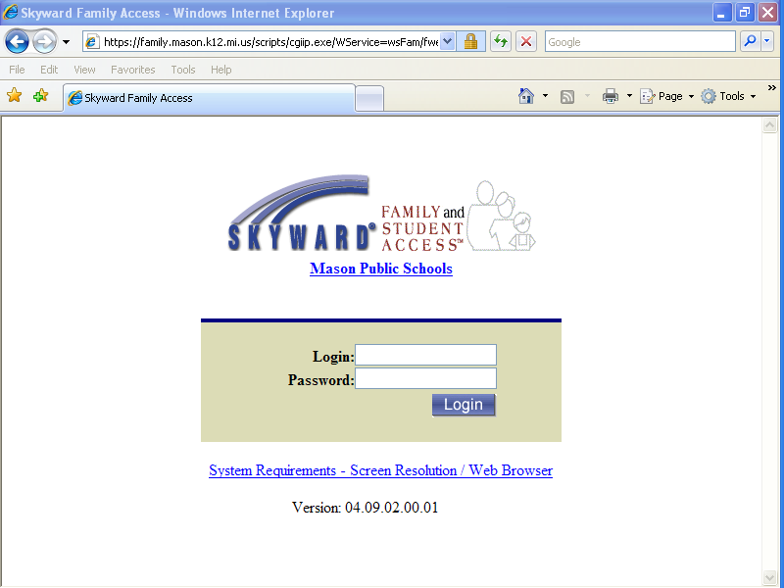
Online Scheduling Instructions
Enter your student login and password into Skyward.
Note: This is different than your parents’ login.

Slide 8
Under Arena Scheduling click Courses for 2017-2018 to get started.

Slide 9
Notice, the options on your screen: View/Print Schedule, Submit Schedule & Messages.

Slide 10
To Search for Classes: Use Period, Subject, and/or Teacher Options
There are multiple pages. Use next arrows to view all.

Slide 11
Search for Classes:
Unique courses such as Online, Dual Enrollment Specialty Courses or special education courses will not appear as an available course to add. They require special applications. Requests to Dual Enroll and to enroll in online classes require a completed and approved application. Applications are found in counseling office. BOTH DUE THIS YEAR FOR ALL OF NEXT YEAR!
BE AWARE of PREREQUISITES! If you enroll in a class for which you are not eligible, counselors will have to take you out and this could mean rearranging your schedule and losing other courses for which you are eligible.

Slide 12
Plan Ahead, Organize
Use the master schedule grid to map out a potential schedule. This will save time and energy searching for classes. It will also let you know if you have a potential schedule conflict ahead of time. PLEASE READ ALL COURSE DESCRIPTIONS and PREREQUISITES. PLEASE CONSULT GRAD REQUIREMENT SHEET.
Colleges like to see a rigorous schedule. Be aware of their admission requirements and expectations. Look at the college website or contact admissions for a freshman profile.

Slide 13
Make your Selections:
To add a class to your schedule, click on the Add button next to the desired class.

Slide 14
Submitting your Classes
Check the placement and balance of your classes. 3 academics/2 electives each tri is a good balance.
Before you submit, obtain parent approval.
IMPORTANT: Do not submit your schedule until you have periods 0-5 FINALIZED for all trimesters. If you would like a special option ( DE, TO, Indep Study, Online….) add alternative electives for now!!
IMPORTANT: Once you have submitted your classes, your scheduling access is turned off and you must wait for counselor approval.
Check back in case your counselor reopens for you to correct an error or make adjustments.

Slide 15
Build your schedule:
Continue to add classes until you have scheduled all 6 for Trimesters 1, 2, & 3.
When you submit, Schedule Status changes!

Slide 16
Reminders
1. You can communicate with your counselor by using the message tab on the scheduling screen. This is not an “instant” message. It is more like an email and may take a couple days for the counselor to return your message.
2. If you leave open spots, counselors will complete your schedule. This may mean rearranging courses you selected. All students must have all fifteen spots filled.
3. You can only access your online scheduling from your grade’s scheduling period. Check handout for dates.

Slide 17
Reminders Continued
4. Once you “submit” your schedule, you cannot make any additional changes without counselor assistance.
5. Your schedule does not become official until it has been approved by your counselor.
6. Check your student access account for messages to you from your counselor and to see if your schedule has been approved.
7. Once your schedule has been completed the only way to change it will be through the drop/add policy IF your change requests meets the drop/add criteria.

Slide 18
Questions ?
You can use the Message tab on the scheduling screen to communicate with your counselor who will review your message and respond during school hours.
Once you submit your message, check back to see the response….. It’s kinda hard to see, look close!!

Slide 19
Remind 101
Class of 2019 Remind 101:
Text to the number 81010
Text this message: @mason2019
To receive important class information and deadlines.

Slide 20
State Testing
April 11- 13, 2017.
Sophomores: PSAT 10 on April 11.
Check for room
Done Early, busses at 2:40

